Slide 1
Homework #2 Answers
Machine Learning EE5354
Javier Salazar 1001144647

Slide 2
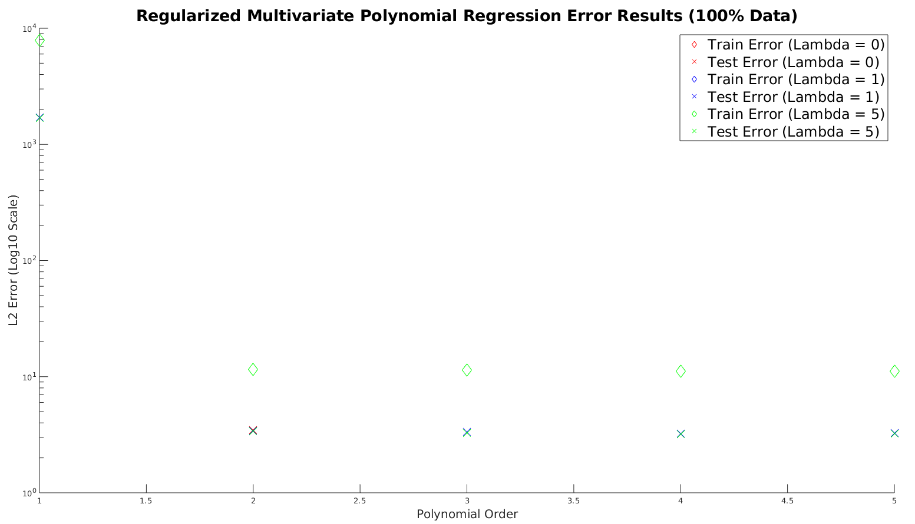
Problem 1 (100% Training Data)

Slide 3
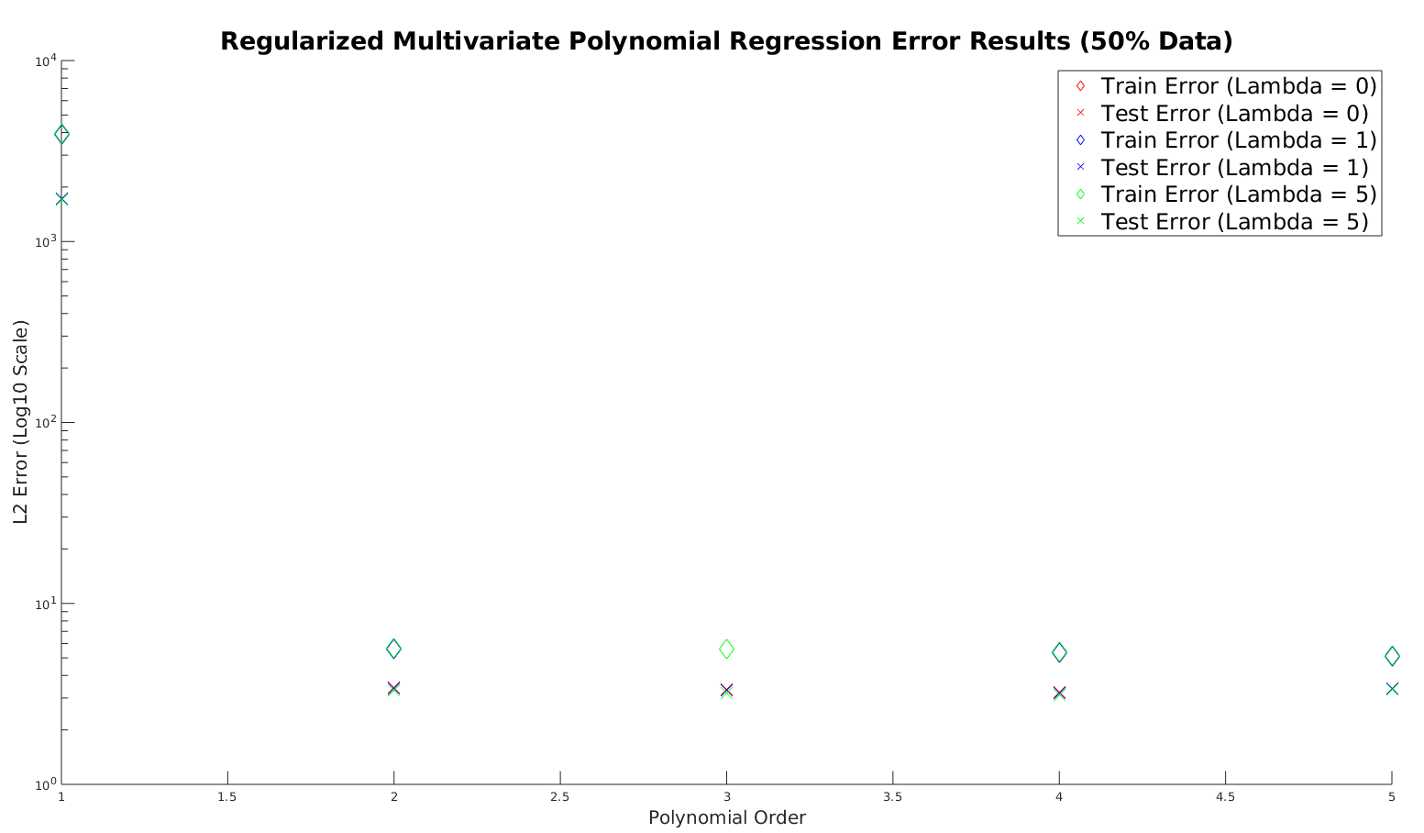
Problem 1 (50% Training Data)

Slide 4
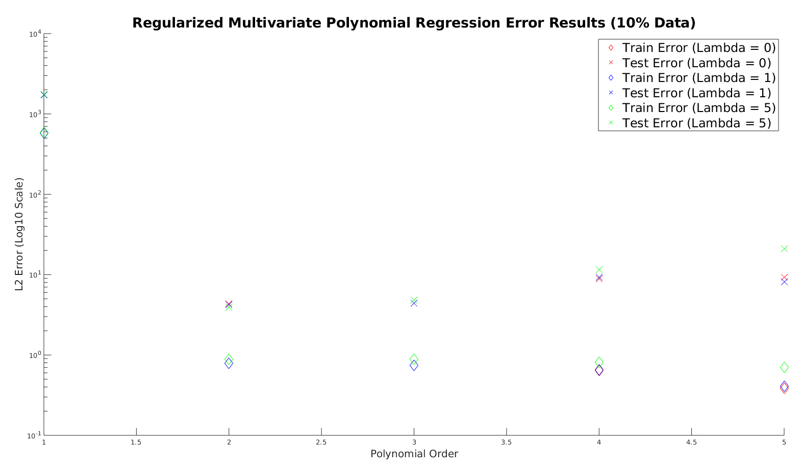
Problem 1 (10% Training Data)

Slide 5
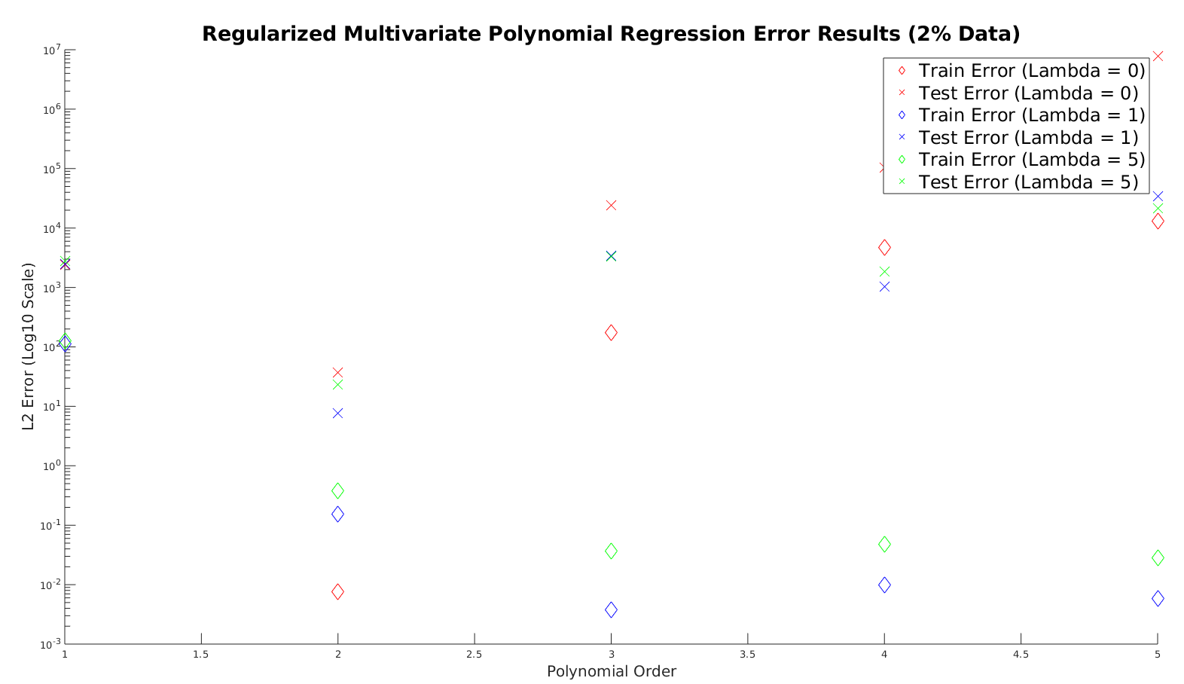
Problem 1 (2% Training Data)

Slide 6
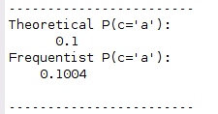
Problem 2
Output when ‘Run’ is pressed
5000 characters
Frequentist approach worked well with large dataset

Slide 7
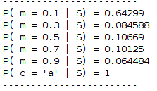
Problem 3
5000 characters
Posterior values for m displayed
Final row shows the posterior values constitute a valid distribution

